Slide 1
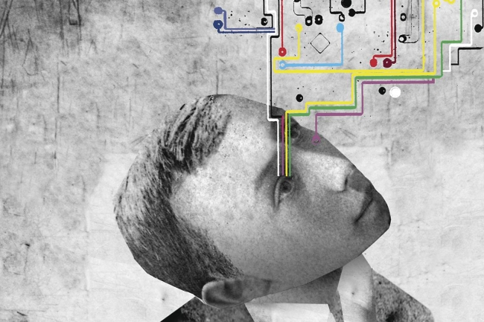
UNDERSTANDING DIGITAL HUMANITIES WEEK 1. INTRODUCTION

Slide 2
How are you? Who are you? Who are we?

Slide 3
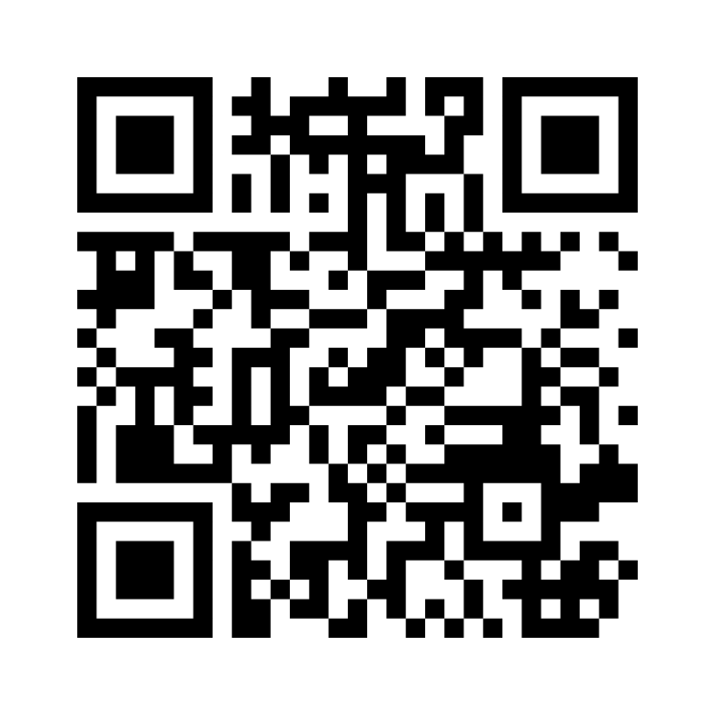
How to define Digital Humanities?
Use three words (without using the word “digital”)
https://www.menti.com/alg9124ozfey

Slide 4
http://whatisdigitalhumanities.com/

Slide 5
Digital Humanities
Field? (inter)Discipline? Label?
An umbrella term for a diverse set of practices and concerns all of which combine computing and digital media within the context of humanities research and teaching
Steven Jones: “defining DH is a known rabbit-hole problem from which one may never return”.
A field in the midst of a growing pain.
The power to stimulate visionary and transformative thinking, to be a site of innovation, reconfiguration, and exploration

Slide 6
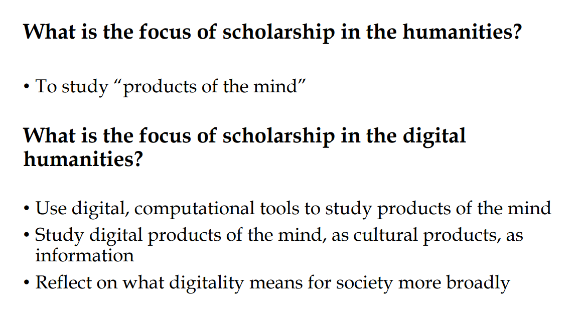

Slide 7
“Will the digital humanities become a separate field whose interests are increasingly remote from the traditional humanities,
or will it on the contrary become so deeply entwined with questions of hermeneutic interpretation that no self-respecting traditional scholar could remain ignorant of its results?
(Katherine Hayles 2012)

Slide 8
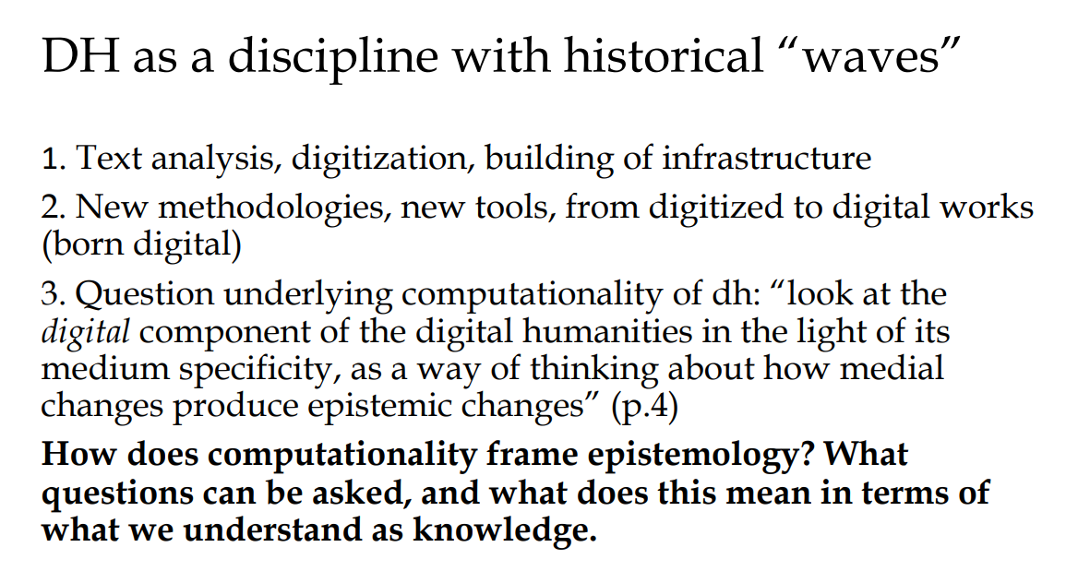
Berry (2012)

Slide 9
Second wave: Digital Humanities
From quantitative to qualitative
From automating corpus liguistics/text-based to multimodal scholarship
Thinking about/through/with new media
Moved to time-based art forms (film, music, design, spatial practices etc)/media studies

Slide 10
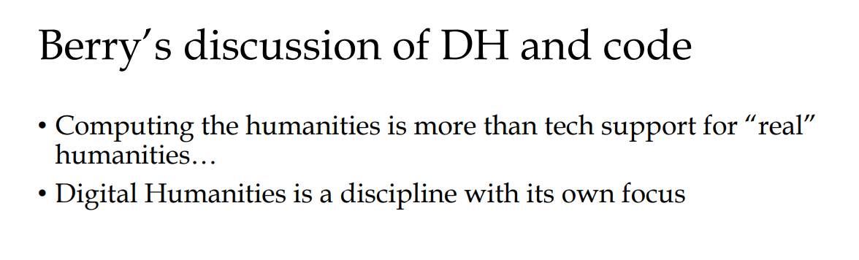
David Berry, "The computational turn: thinking about the digital humanities", Culture Machine 12.0
Third Wave Digital Humanities?

Slide 11
Gold & Klein (2019)
DH: The Expanded Field
Debates in the Digital Humanities
openness and inclusivity of the Big Tent?
no tent but relationships among key concepts, forms, and practices
importance of field-specificity
alternative histories of DH

Slide 12
Fiormonte, Chaudhuri & Ricaurte (2022)
Global DH
Global Debates in the Digital Humanities
reassessment of North-South and East-West relations
repair invisibility and cultural and linguistic underrepresentation
infrastructural advantages and inequalities

Slide 13
Global DH? ADHO.org
European Association for Digital Humanities (EADH)
Association for Computers and the Humanities (ACH)
Canadian Society for Digital Humanities / Société canadienne des humanités numériques (CSDH/SCHN)
Australasian Association for Digital Humanities (aaDH)
Japanese Association for Digital Humanities (JADH)
Humanistica, L’association francophone des humanités numériques/digitales (Humanistica)
Digital Humanities Association of Southern Africa (DHASA)
Taiwanese Association for Digital Humanities (TADH)
Red de Humanidades Digitales (RedHD)
Association for Digital Humanities in the German Speaking Areas (DHd)
Digital Humanities Alliance for Research and Teaching Innovations (DHARTI)
Korean Association for Digital Humanities / 한국디지털인문학협의회 (KADH).

Slide 14
Global DH at RUG
Graphs and Ontologies for Literary Evolution Models (golemlab.eu) – Korean, Indonesian, Spanish, Italian, English
The Platformization of Music – NL, South Korea, Nigeria

Slide 15
DH
scholarship presented in digital form(s)
scholarship enabled by digital methods & tools
scholarship about digital technology & culture
scholarship building and experimenting with digital technology
scholarship critical of its own digital-ness
https://researchguides.wcu.edu/digitalhumanities

Slide 16
Break out session: use your notes (A0) and discuss with your peers:
Your name
Your academic background
The main object of your studies so far
Your expectations about DH (see next slide)

Slide 17
Break out session: Discussion points
Digital Humanities: the interdisciplinary potential of a genuine collaboration between data science, critical theory, and media studies. DH should not only focus on how digital tools could improve research methods within the humanities, but also on what the humanities could do to provide critical knowledge about the digital (cf. well-researched concepts identity, interpretation, representation, or meaning) – DH ≠ a one-way street.
Relevance of DH? What are the conditions of thinking (i.e. acting) in the world today (i.e. after the computational-turn)? DH as a new philosophy producing computational/data-centric subjects?

Slide 18
Break out session: Output
one group member will summarize the key points of the discussion within the group

Slide 19
Position of Understanding Digital Humanities in the MA program
Theoretical learning pathway
UDH
Data in Society
Data and software as culture
Thesis/thesis lab

Slide 20
Overview of the course
NB. Please check the button Course Documents and Assignments for an elaborate introduction of the weekly readings and assignments.
week 1: Introduction: What is DH? Exploring a new field
week 2: I see a pattern! The case of Distant Reading (graded assignment)
week 3: DH as an infrastructural project
week 4: DH as Inter, Multi or Transdisciplinary field (graded assignment)
week 5: Digital Hermeneutics
week 6: AI and Cultural Analytics
week 7: Preparing final essay
group meetings will be scheduled

Slide 21
Mode of assessment
Students will weekly prepare short assignments that will be discussed during the seminar sessions. The final assessment will be based on an essay (2000 words) that reflects the topics and literature that were discussed during class.

Slide 22
Final essay
In your final essay you will have the chance to explore a topic/case/statement/problem/project/tool you find interesting, related to one of the 6 topics (weeks) explored during the course
Step 1: Prepare your proposal. Please make sure that you have a research question, a motivation (why you think this is interesting), overview of cases, theories, approaches and/or methods that you would like to discuss. Upload your proposal on Brightspace before Thursday, October 12.
Step 2: In week 7, we will meet you in small groups and give you feedback.
Step 3: Write your essay!
Tip 1: Make notes during the weekly sessions about topics of your interest.
Tip 2: There is a resource that can help you writing an essay: https://writingcenter.fas.harvard.edu/pages/essay-structure

Slide 23
Assignment A1
After class, you are asked to produce a second report A1 with some further reflections by answering the following question: How is your academic discipline located within the Digital Humanities today?

Slide 24
Assignment A1
Before you answer this part of the assignment, please research DH as a field:
when did DH start, try to describe how the field defines itself;
briefly describe what the trending topics are and explain if and how they relate to your academic discipline;
list the main journals, books (and book series), and conferences, reflecting on how they focus on specific areas of DH;
mention at least two articles/books that you think are important for your discipline in relation to DH;
try to indicate tools, theories, and methods.
The mandatory and suggested reading are only a starting point

Slide 25
Assignment A1
Tips:
You are allowed to do the research in collaboration with other students and share the results. But the report should be submitted individually since the central question is related to your own disciplinary background.
Your academic discipline may be either that of your previous university education or a new discipline/area you'd like to work in.
Requirements:
you need to use and cite the required readings
list max 10 items
answer in max 500 words (references excluded)
PDF only.
Upload your report as A1 (use as title: surname-name_S-number_reportA1.pdf) on Brightspace before Thursday September 7, 17:00.

Slide 26
Next week
Distant reading
Materials will be available on Brightspace tomorrow (Tuesday 5) morning.

Slide 27
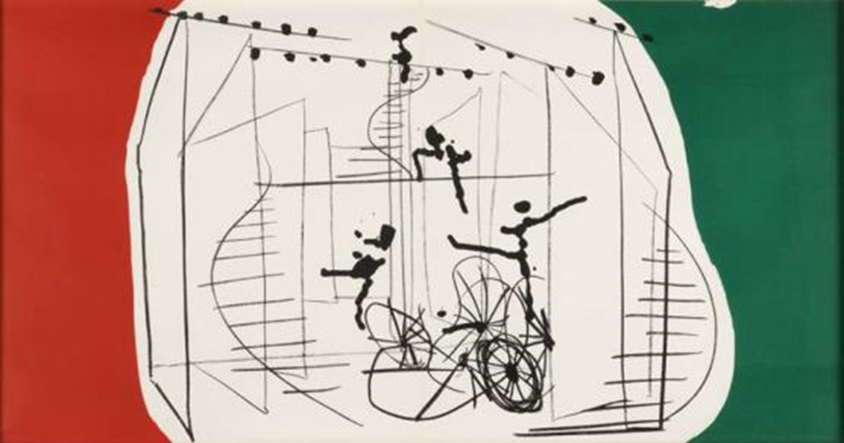
Final remarks
Read, read, read….
Ask questions
Propose projects/topics to discuss
Enjoy the year..
Constant 'New Babylon', 1963

